Slide 1

HTML Day 2: Semantic Formatting & Tables
Welcome back to HTML Basics! Today, we're diving deeper into the language of the web, exploring how to structure content with meaning and present data elegantly. We'll uncover the power of semantic HTML and master the art of building tables.

Slide 2





Semantic Formatting: More Than Just Appearance
Semantic HTML tags provide meaning to content, not just styling. While <b> and <strong> might look similar visually, their underlying purpose is distinct.
<b> vs. <strong>
<strong> for Importance
The <b> tag is for making text bold for presentational purposes, without conveying any extra importance. Think of it like making a word stand out in a newspaper headline.
The <strong> tag indicates that the enclosed text has strong importance, seriousness, or urgency. Screen readers will often emphasize this text. It's about meaning, not just looks.
<p>This is <b>just bold</b> text.</p>
<p>This is <strong>important</strong> text.</p>
Beyond bolding, HTML offers tags for various textual nuances:
<mark> (Highlight)
<del> (Deleted)
<ins> (Inserted)
Highlights text, often used for relevance in a search result.
Indicates text that has been deleted from a document.
Represents text that has been added to a document.
<mark>New Feature</mark>
Old Price: <del>$99</del>
New Price: <ins>$79</ins>

Slide 3
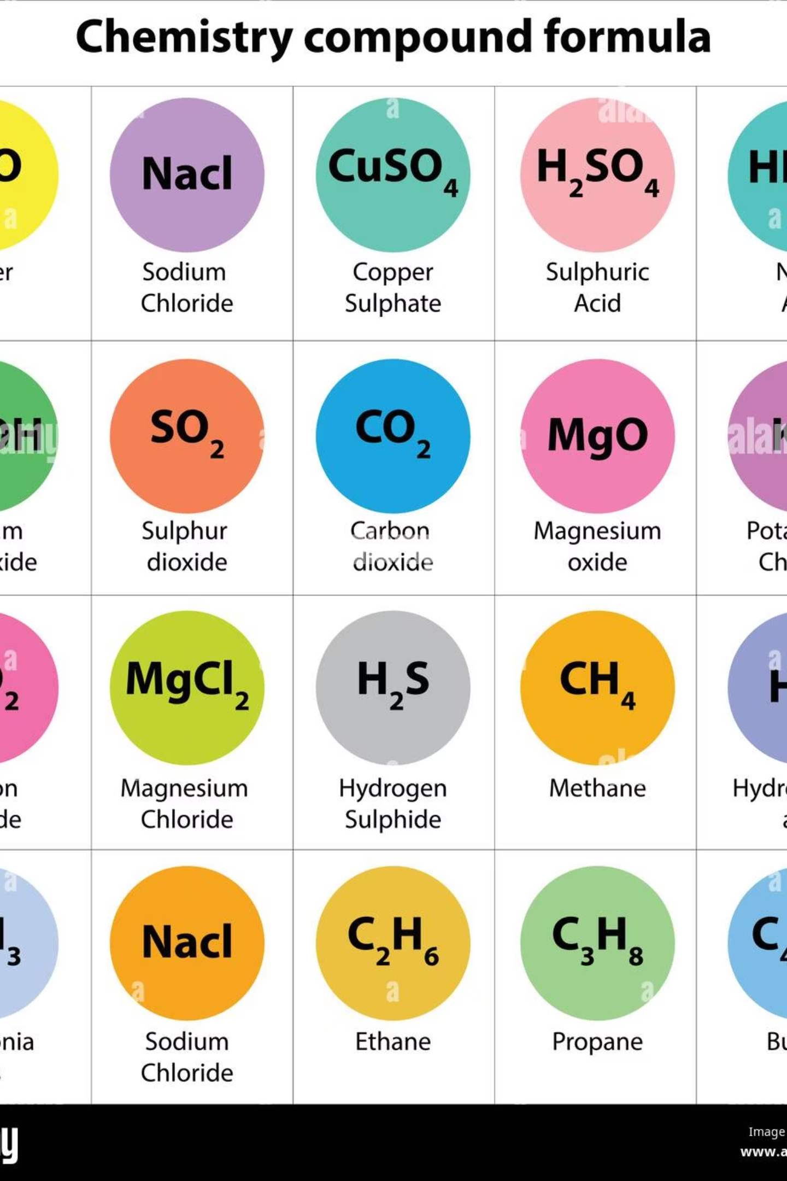

Scientific Notation & Contextual Text
HTML also provides tags for scientific notations and contextual text, making your content more precise and accessible.
<sub> (Subscript)
<sup> (Superscript)
Renders text as subscript, typically for chemical formulas or mathematical expressions.
Renders text as superscript, useful for footnotes, exponents, or ordinal indicators.
H<sub>2</sub>O is water.
E=mc<sup>2</sup> is famous.
Example: H2O
Example: E=mc2
Why use semantic tags?
Semantic tags improve accessibility for screen readers, enhance SEO, and make your code easier to read and maintain. They clearly define the purpose of content, not just its appearance.

Slide 4




Quotations and Abbreviations
Properly citing sources and defining abbreviations are crucial for academic and professional content. HTML offers specific tags to handle these elements semantically.
<blockquote>
<q>
Used for long quotations that are block-level. Browsers usually indent this content.
Used for shorter, inline quotations. Browsers often add quotation marks automatically.
<blockquote cite="https://www.w3.org/standards/webdesign/">
<p>Web design is a broad term...</p>
</blockquote>
<p>He said <q>Hello World</q> to me.</p>
<abbr>
Defines an abbreviation or an acronym. The title attribute provides the full description.
<abbr title="HyperText Markup Language">HTML</abbr>
"Good content isn't about good storytelling. It's about telling a true story well."
— Ann Handley, Chief Content Officer of MarketingProfs

Slide 5



Developer Tools: Comments & Favicons
As you write more complex HTML, developer tools become indispensable. HTML comments help you organize your code, while favicons provide a visual identity for your web pages.
HTML Comments: <!-- -->
Adding a Favicon
Comments are non-rendering annotations within your code. They are crucial for explaining complex sections, temporarily disabling code, or leaving notes for yourself and other developers. They are ignored by the browser.
A favicon is the small icon displayed in the browser tab, bookmarks, or browser history. It enhances brand recognition and user experience. To add one, link to an .ico or .png file in your document's <head> section.
<!-- This is a comment -->
<p>Visible text.</p>
<!-- <h1>Hidden Heading</h1> -->
<head>
<link rel="icon" type="image/x-icon" href="/images/favicon.ico">
</head>
Always use descriptive comments. Future you (and your teammates) will thank you!

Slide 6

HTML Tables: Structuring Tabular Data
Tables are used to display data in a grid format. They are ideal for presenting information that is best understood when organized in rows and columns, such as financial data, product specifications, or contact lists. Avoid using tables for page layout.
1
<table>
The main container for all table content.
2
<tr>
Defines a table row. Each <tr> element encloses one row of cells.
<th>
3
Defines a table header cell. Typically, these are bold and centered by default, acting as labels for columns or rows.
4
<td>
Defines a table data cell. These are the standard data cells within your table.

Slide 7
Building a Basic HTML Table
Let's construct a simple table to see how these tags work together. We'll create a table for product features, showcasing how headers and data cells organize information effectively.
<table>
<tr>
<th>Feature</th>
<th>Description</th>
<th>Value</th>
</tr>
<tr>
<td>Processor</td>
<td>Intel Core i7</td>
<td>2.8 GHz</td>
</tr>
<tr>
<td>RAM</td>
<td>DDR4 SDRAM</td>
<td>16 GB</td>
</tr>
</table>
This code produces a structured table like the one below, making it easy to compare features at a glance.
Feature
Description
Value
Processor
Intel Core i7
2.8 GHz
RAM
DDR4 SDRAM
16 GB
Storage
SSD
512 GB

Slide 8
Advanced Table Features: Spanning Cells
Sometimes, you need cells to span across multiple columns or rows. This is where colspan and rowspan attributes come in handy, allowing for more complex and visually appealing table layouts.
colspan
rowspan
The colspan attribute specifies the number of columns a cell should span. It's useful for creating headings that cover multiple data points.
The rowspan attribute specifies the number of rows a cell should span. This is often used for categorizing items or grouping related content vertically.
<table>
<tr>
<th colspan="2">Product Details</th>
</tr>
<tr>
<td>Name</td>
<td>Widget X</td>
</tr>
</table>
<table>
<tr>
<th rowspan="2">Category</th>
<td>Item A</td>
</tr>
<tr>
<td>Item B</td>
</tr>
</table>
Product Details
Name
SuperWidget 3000
Model No.
SW-3000
Specifications
Weight: 1.5 kg
Battery Life: 10 hrs
These attributes enable you to create more complex and organized tables, adapting to diverse data presentation needs.

Slide 9
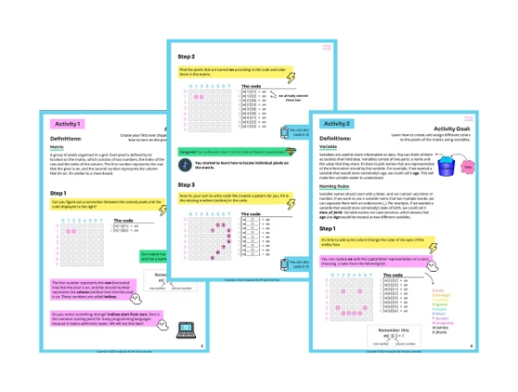
Key Takeaways: Semantic HTML & Tables
Today, we've explored how to build more meaningful and structured web content. By using semantic tags and well-formed tables, you enhance both the user experience and the underlying code quality.
Semantic HTML
Comments & Favicons
Adds meaning to content for better accessibility and SEO.
Essential for code maintenance and brand identity.
HTML Tables
Practice Makes Perfect
Structure data effectively with <table>, <tr>, <th>, and <td>.
Continue building and experimenting to master these concepts.
Keep practicing these concepts as they form the backbone of well-structured and accessible web pages. Next, we'll delve into forms and user interaction!

